Slide 1
Interstate network – Issues Paper
Australian Competition & Consumer Commission
9 September 2021
Sli.do #INTISSU1

Slide 3
Welcome
Anna Brakey
Commissioner
Australian Competition & Consumer Commission

Slide 4
Agenda
Introduction to Issues Paper and Interstate network
Current regulation
Regulatory framework options
What is the level of competition?
Interstate rail stakeholders
Q&A - Sli.do #INTISSU1

Slide 5
Interstate network – Issues Paper consultation
Current regulation: are changes required?
Issues Paper published – 24 August
ACCC presentation – today
Hosting meetings in stakeholder groups or individuals – 13–24 September
ACCC presentation: Update on findings – 28 September
Submissions due – 6 October
Following consideration of stakeholder feedback, the ACCC will further develop options for discussion

Slide 6
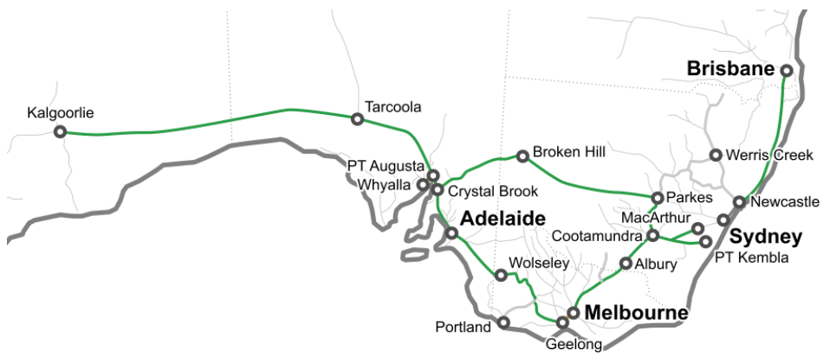
Map of ARTC’s Interstate network
Source: ARTC, Defined Interstate Rail Network, accessed 31 August 2021. www.artc.com.au/customers/standards/route/access/defined-interstate/

Slide 7
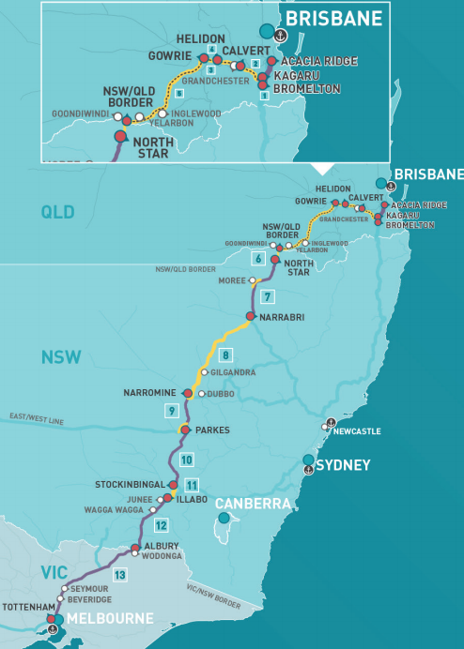
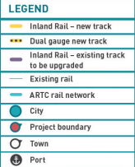
Map of ARTC’s Inland Rail route
Source: ARTC, Map of Inland Rail route, accessed 31 August 2021. https://inlandrail.artc.com.au/map-of-inland-rail-route/

Slide 8
Current regulation: Access Undertaking
Current voluntary Interstate Access Undertaking,
- access terms and conditions
- information disclosure including publishing prices
- dispute resolution processes
- access charges (revenue) based on:
ceiling limit Regulatory Asset Base (RAB) or Depreciated Optimised Replacement Cost (DORC) methodology
floor limit ‘incremental’ costs (operational costs)

Slide 9
Regulatory framework options
Full regulation
“Light” regulation
Negotiate-arbitrate
Monitoring

Slide 10
Regulation can include:
What regulation can do depends on the design.
Different forms of regulation may include:
terms and conditions of access, including capacity rules and sharing of risks
minimum service standards
revenue and pricing (including structure)
dispute resolution process
information disclosure/transparency
default contract
monitoring and threat of greater regulation

Slide 11
Regulation does not include:
Over the longer term, does not guarantee lower prices / no price increases
Being cost free: regulation costs the service provider, stakeholders and the regulator
Reforms to road or shipping regulation. These are outside the scope of this review on rail

Slide 12
Why is the level of competition important?
Competition means consumers have viable options.
Lack of competition can:
lead to access restrictions (no access/discrimination between users)
increase prices above competitive prices (rent seeking)
lower service standards

Slide 13
What is the level of competition?
Rail has competition with road, air and ports.
For example:
Short-distance freight market
Long-distance freight market
Passenger carriage
Other stakeholders
Location / route
What has changed since 2008?

Slide 14
Rail reform: Questions from the Issues Paper
ARTC’s upcoming voluntary Access Undertaking
Current and future regulatory framework?
Where is there competition?
Legislative change?
Minimum delivery standards?
Captive customers and market power?

Slide 15
Next steps
Meetings with staff in stakeholder groups. Can also have meetings with Anna.
Submissions close Wednesday, 6 October 2021
Contact Justin Martyn justin.martyn@accc.gov.au
Q&A with Anna now Slido questions #INTISSU1 Staff also available to answer questions

