Slide 1
Consumer Data Right in Energy
Stakeholder forum: data access models for energy data consultation
18 March 2019

Slide 2
Overview
Introduction
Overview of data access model options
APIs in the CDR context
Discussions
Data access models
Any other issues

Slide 3
Data access models overview
The consultation paper focuses on the potential data access models for accredited data recipients
Models
Model 1: the AEMO centralised model
Model 2: the AEMO gateway model
Model 3: the economy-wide CDR model
Assessment criteria includes:
User functionality
Reliability
Security
Privacy

Slide 4
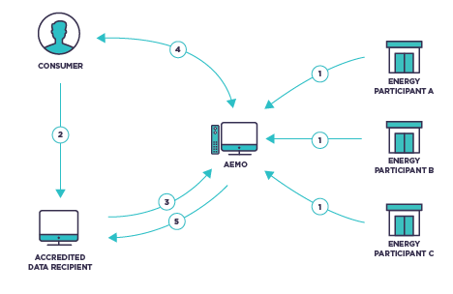
Data access model 1: AEMO centralised model

Slide 5
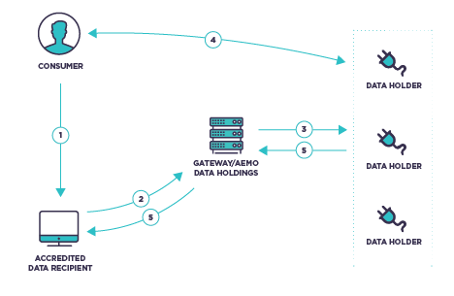
Data access model 2: AEMO gateway model

Slide 6
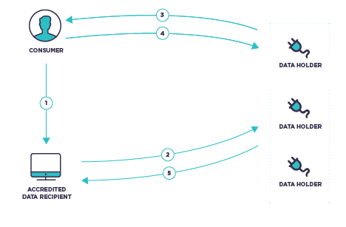
Data access model 3: economy-wide CDR model

Slide 7
Assessment criteria
User functionality
Reliability, security, privacy
Efficiency of relevant market
Cost effectiveness
Interoperability
Flexibility and extensibility

Slide 8
What is an API?
Data61 Presentation for the ACCC
March 2019

Slide 9
CDR JARGON
Accredited Data Recipient (ADR)
All data recipients who receive consumer specific data must be accredited. It is proposed that there will be different levels of accreditation to reflect the different risks associated with different data sets and data uses. Breaches of their obligations under the right, or general privacy law, may give rise to the removal, suspension or imposition of conditions on a data recipient’s accreditation.
The information technology systems required under the right will block non- accredited entities from accessing data.
Data Holder
Holders of designated data in a designated sector who must release consumer’s data in a machine readable format at the consumer’s consent.

Slide 10
CDR JARGON
Designated Gateway
An entity designated by the Minister for facilitating the transfer of information between data holders and accredited data recipients. However, it is not yet clear if any designated gateway will apply in the initial sector. The Government currently "expects that there will be limited circumstances when a gateway will be designated”.

Slide 11
Application Programming Interface (API)
While there is no one distinct definition of an API, an API is essentially a piece of software that allows two applications to talk to each other; in this case the applications in question belong to the accredited data recipient and the data holder. APIs are the standard mechanism for sharing information between software securely and efficiently. They enable interconnectivity between services, providing standardisable ways to access, interpret and present data on a server.

Slide 12
What is an API?
Definition…
API: Application Programming Interface. A set of software functions and procedures allowing the creation of applications that securely access the features or data of an application, system or service.
Notes:
While there is no specific definition this definition, derived from Wikipedia and other sources, encapsulates most of the characteristics of APIs that are relevant for the context of the CDR

Slide 13
What is an API?
Definition…
API: Application Programming Interface. A set of software functions and procedures allowing the creation of applications that securely access the features or data of an application, system or service.
Notes:
Specific comments related to this definition:
An API is always software. It represents an automated and systemic form of access used by independent software systems. APIs are not used directly by people and are not substitutable with manual processes
APIs are used for accessing data and services securely
APIs can be used for features and data. Using Insurance as an example, the same API set can be used to list past claims as well as to submit a new claim.
APIs are used to access an existing system that provides services

Slide 14
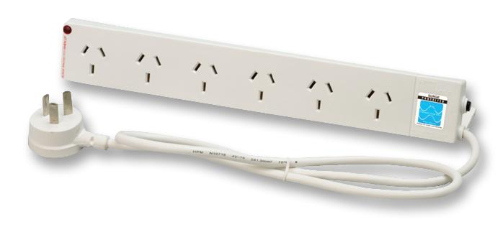
APIs are like…
Standardised &
Reusable
Notes:
Everyone is familiar with power points, and the fact than when we travel we often encounter other types of power points in other countries.
This is an example of the use of standards to create interoperability between products created by different organisations that do not need to collaborate. In the example of power the makes of appliances and the makers of house fittings can be confident that their products will be interoperable without exhaustive testing.
APIs are similar in they create a standard, reusable model for interoperability that does not require exhaustive testing of both systems for integration to be successful.

Slide 15
APIs are like…
Short, Fast &
Interactive
Notes:
The use of APIs is similar to SMS text messages.
An SMS is short, fast and expected to be interactive. It is not unusual for a series of SMS messages to be sent interactively between two parties. On the other hand, an email is larger, sent less frequently and there is no expectation of immediate response.
In the same way an API is expected to be an interactive and short form of interaction. This is contrast to traditional forms of data transfer such as Secure FTP.

Slide 16
APIs are like…
A web page with data instead of content
Notes:
The way modern APIs work is equivalent to the use of web pages in a browser. The techniques and protocols are almost identical.
The one key difference is that an API responds with raw, unadorned, data whereas a web page will incorporate formatting and styling to allow the data to be displayed to a human. This makes the data obtained from API highly flexible as it can be transformed and presented at the discretion of the client system as opposed to the serving system.

Slide 17
APIs are NOT…
A way of storing or analysing data
Complex or complicated to implement
A substitute for data aggregation

Slide 18
API JARGON
OPEN / PUBLIC API
PRIVATE API
Notes:
OPEN API – An API that has been built with the expectation that other entities will use it.
PRIVATE API – The opposite of an OPEN API. An API that is created only for the use of the organisation that created it.
PROPRIETARY API – Another name for a PRIVATE API.
PUBLIC API – A form of OPEN API that is available for use by external entities and is unsecure (ie. the client using the API does not need to provide any authorisation or authentication).
SECURE API – A secure form of OPEN API where the client (and potentially a 3rd party as well) needs to authenticate and obtain authorisation before being able to use the API.

Slide 19
ENERGY SECTOR DATA ACCESS MODELS
Sole data holder
‘Gateway’ to data holders
Economy-wide CDR model

Slide 20
QUESTIONS
THANK YOU!

Slide 21
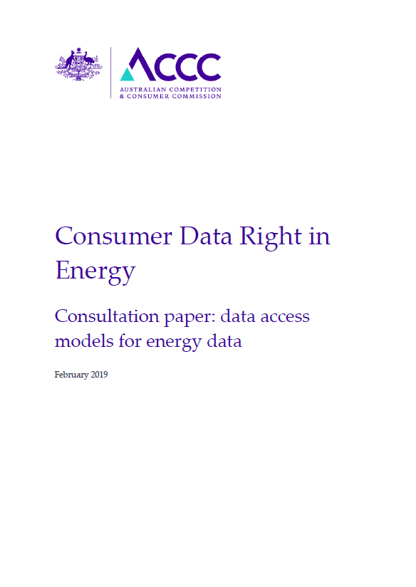
Other issues for discussion …

Slide 22
Consultation & timeframes
Consultation closes 5pm 22 March 2019
Queries can be directed to the CDR inbox: ACCC-CDR@accc.gov.au

